Slide 1



15 - 17 NOVEMBER
2026
OLYMPIA
LONDON
Notes:
‹#›

Slide 2


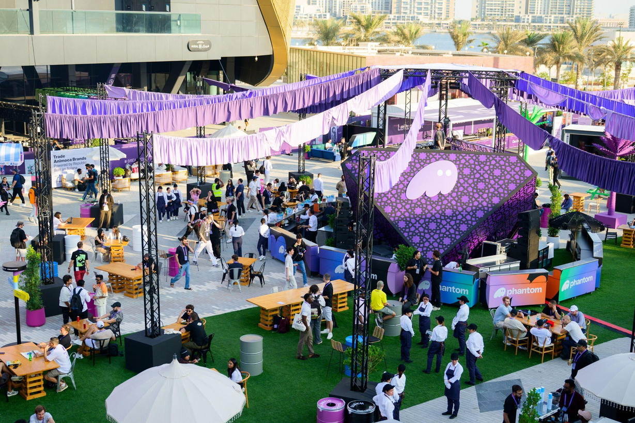
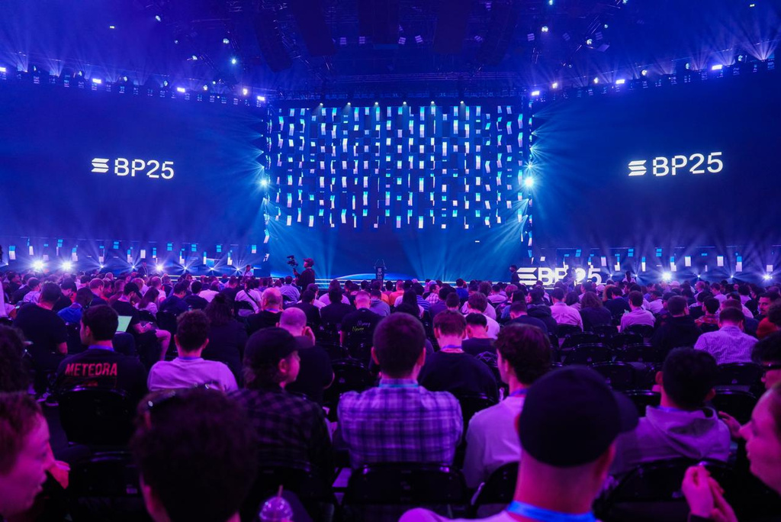

Last Year’s Highlights
7K+
1
110+
258+
170+
attendees
conference
stage
Sponsors
speakers
side events
Notes:
‹#›

Slide 3


Sponsorship Prospectus
2026
15-17
Olympia
Schedule At-A-Glance
NOV 15
DAY 0
Registration Opens
Welcome Mixer 4-7pm
NOV 16
DAY 1
Keynote Programming Begins All Conference Live Programming Running at the Conference Venue.
NOV 17
DAY 2
Keynote Programming Running at the Conference Venue.
NOVEMBER
London, UK
*Noting that programing may vary
Notes:
‹#›

Slide 4
Attendee Expectations
FOR BREAKPOINT 2026 WE EXPECT:
7K+ ATTENDEES
from 100+
countries
100+ product
announcements
Infinite energy
Please note we do not share our attendee lists
In any way, shape or form… (don’t ask, thanks!)
Registration
Register at: solana.com/breakpoint
Interested in Speaking
Sponsorships do not include speaking slots.
***Speakers are vetted independently of sponsorship support.
To be considered, tell us more about why you should take the stage. Applications will go live on the Solana website in the Summer of 2026.
Notes:
‹#›

Slide 5


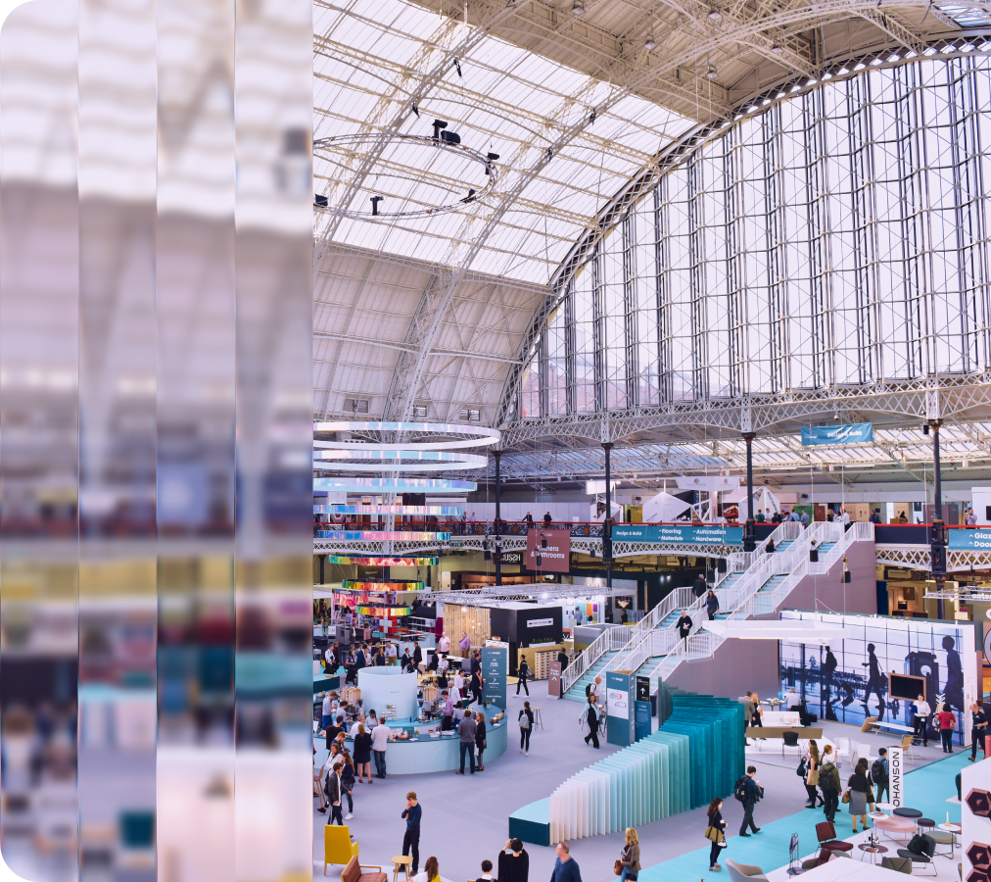
Olympia
LONDON
Olympia London offers over 430,000 ft² of event space across seven venues, with soaring 19-meter ceilings, large loading access, and integrated production infrastructure.
Located in West Kensington with excellent transport links, it accommodates everything from 10,000-person exhibitions to high-end conferences, live shows, and brand activations.
Breakpoint 2026 will take place in
the Grand Hall and the West Hall Level 1.
Main Stage
Capacity
Hospitality Lounge
Capacity
Product HQ
Capacity
~1400
~3000+
~500+
Notes:
‹#›

Slide 6



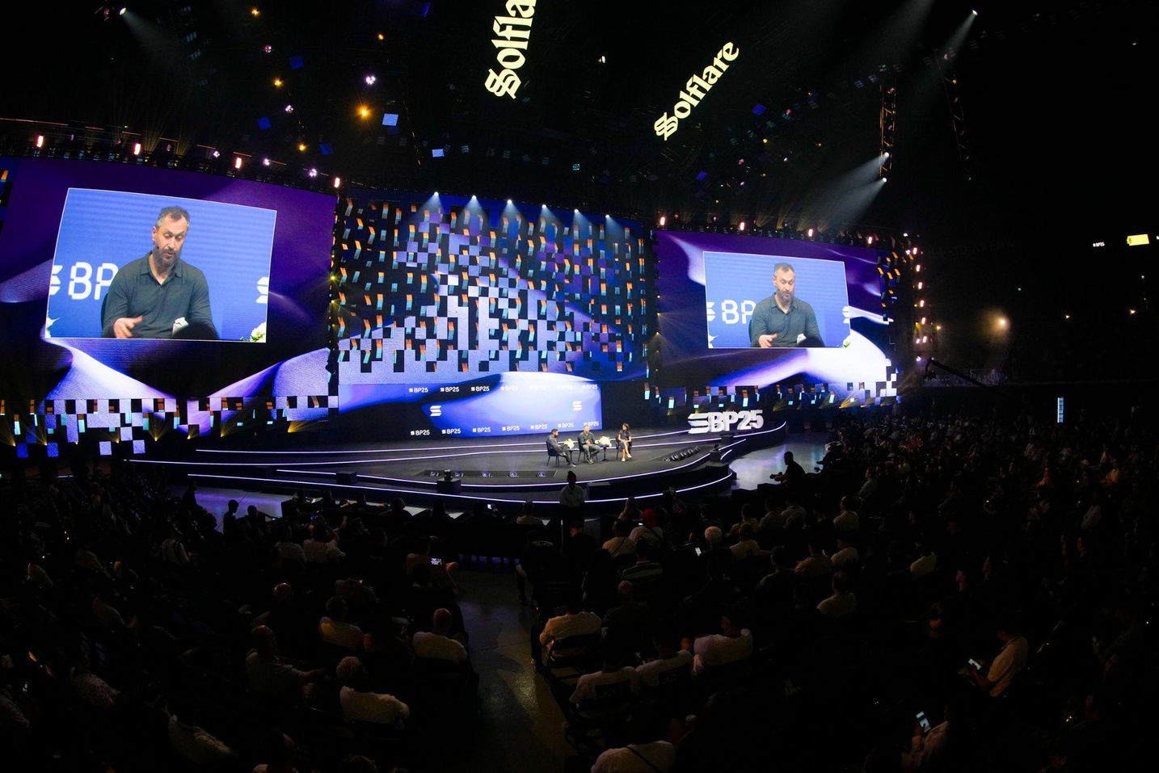
Sponsorships
MAIN STAGE
Objective
The Main Stage at Breakpoint 2026 brings together the founders, builders, policymakers, investors, and innovators shaping the next era of open finance, global payments, and decentralized infrastructure.
Across two days of keynotes, product unveilings, ecosystem spotlights, and high-impact conversations, experience how Solana’s network, applications, and community are defining the future of the internet on a truly global stage.
— Bold, fast, and built for what’s next.
Capacity
Open
Pricing
~1400
Nov 16-17, 2026
10am - 7pm
See next slide for pricing and specifications.
Notes:
‹#›

Slide 7


Sponsorships
MAIN STAGE
Anchor Tenant
Speaker Lounge
Live Stream
What’s included?
What’s included?
What’s included?
(1) Main Stage - Exclusive Sponsorship
Position your brand at the heart of the conference experience by sponsoring the exclusive Speaker Lounge: the go-to space for speakers, moderators, and special guests.
In addition to an incredible IRL experience, we’re offering a livestream of conference programming to audiences around the globe.
Content will be streamed across several platforms including Solana’s Twitter Live with over 3 million followers!
  (1) Luxury Suite
  Prominent signage at the Main Stage
  Branding Tier: Anchor
  Access to the Speaker Lounge
  Branded Banner in the Grand Hall
  Exclusive branding in the Grand Hall
  Mentioning in Press Release
  Recognition on conference website and in conference materials, with amplifications on Breakpoint socials, owned marketing channels and more.
  Branded furniture & charging stations
  Dedicated Monitors to display signage and/or product marketing
  Fully stocked bar and daily refreshments
  (open 10am - 7pm daily)
  Branded Banner in the Grand Hall
  (20) Access passes for the Speaker Lounge
  Recognition on conference website and in conference materials, with amplification on Breakpoint social, owned marketing channels, and more.
  1 x Full Banner of Advertising Space on the digital frames during the livestream
  Large scale print branding skyline marketing in event space
  Branded Banner in the Grand Hall
  Recognition on conference website and in conference materials, with amplification on Breakpoint socials, owned marketing channels, and more.
Investment:
Passes:
Investment:
Passes:
Investment:
Passes:
$850,000
45 GA
$250,000
20 GA
$150,000
15 GA
Notes:
‹#›

Slide 8


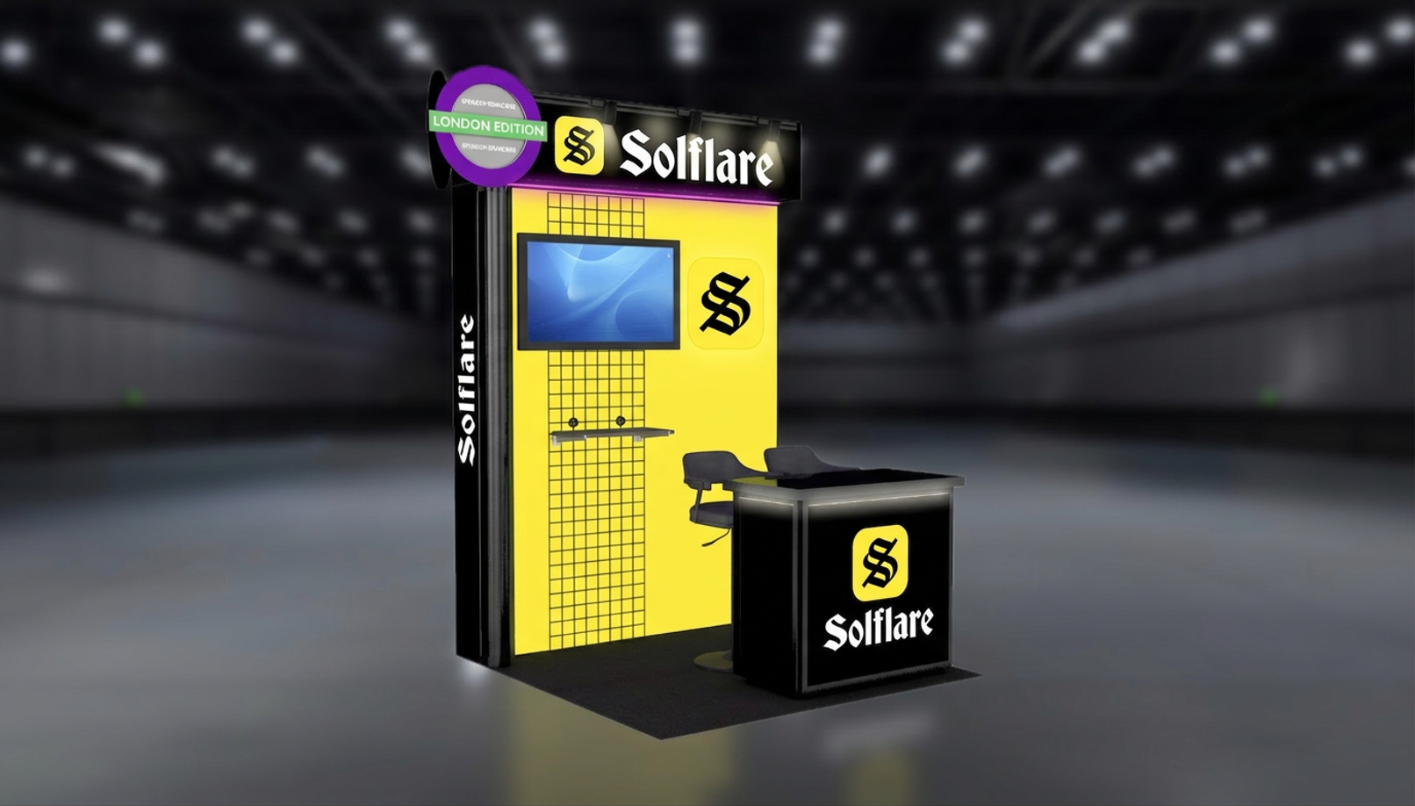
Sponsorships
BOOTHS
Product Kiosk (6’x6’)
The Product Kiosk is where you showcase what you’re building on Solana! Demo live, meet future users and partners and get discovered by the wider ecosystem.
We handle the setup so you can plug in, tell your story, and start meaningful conversations from the moments doors open.
What’s included?
  Turnkey 6’ x ‘6 Kiosk
  (2) High stools & (1) Welcome Counter
  (1) 43’’ Monitor (incl. USB and HDMI input)
  Power socket
  Recognition on conference website and in conference materials, with amplification on Breakpoint social, owned marketing channels, and more.
  (2) Design Revision rounds
Investment:
Passes:
$15,000
4 GA
Notes:
‹#›

Slide 9


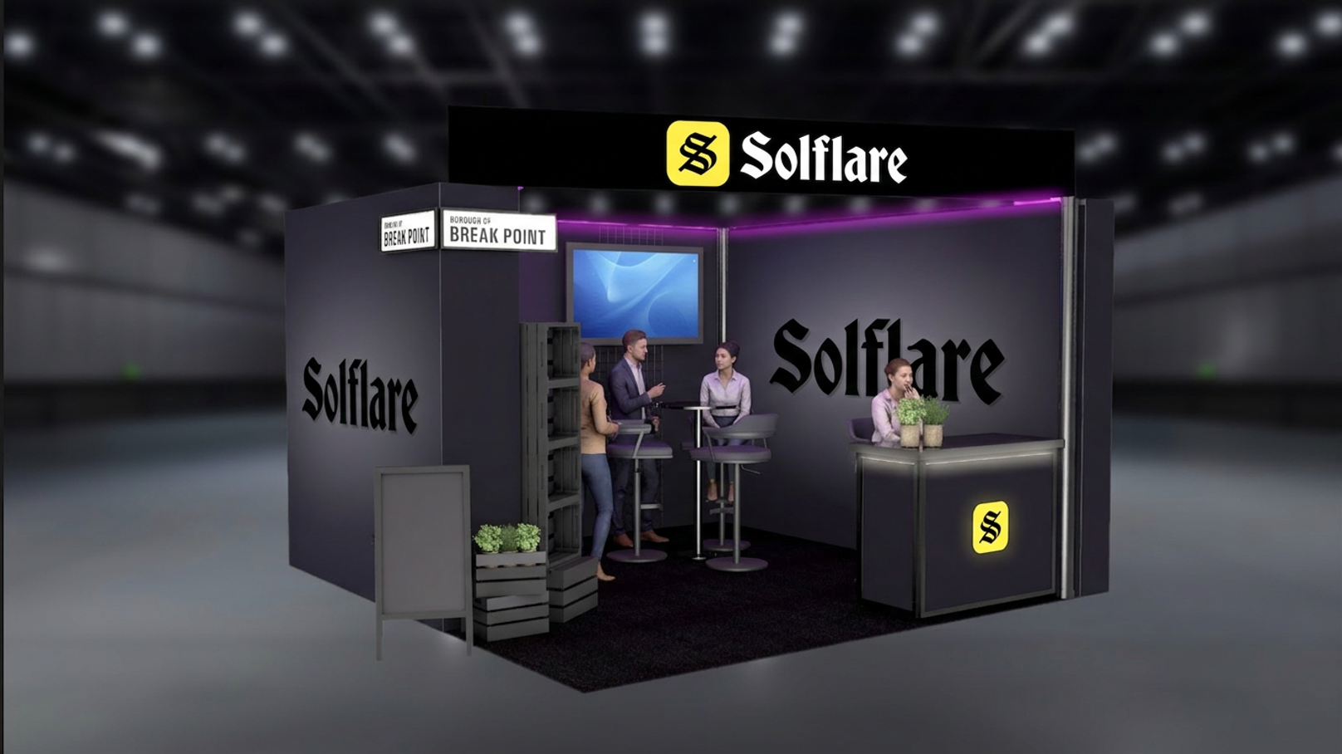
Sponsorships
BOOTHS
Deluxe Suite (13’x13’)
Deluxe Suites are where teams can showcase products and teams building on Solana, but in need of a bigger space than the Product Kiosk.
Enough space for not only showcasing your product, but ample room to network!
What’s included?
  Turnkey 13’x13’ suite to entertain, educate and network
  Fully furnished with integrated seating
  (1) 43’’ Monitor (incl. USB and HDMI input)
  Power socket
  Custom signage
  Recognition on conference website and in conference materials, with amplification on Breakpoint social, owned marketing channels, and more.
  (2) Design Revision rounds
Investment:
Passes:
$55,000
5 GA
Notes:
‹#›

Slide 10


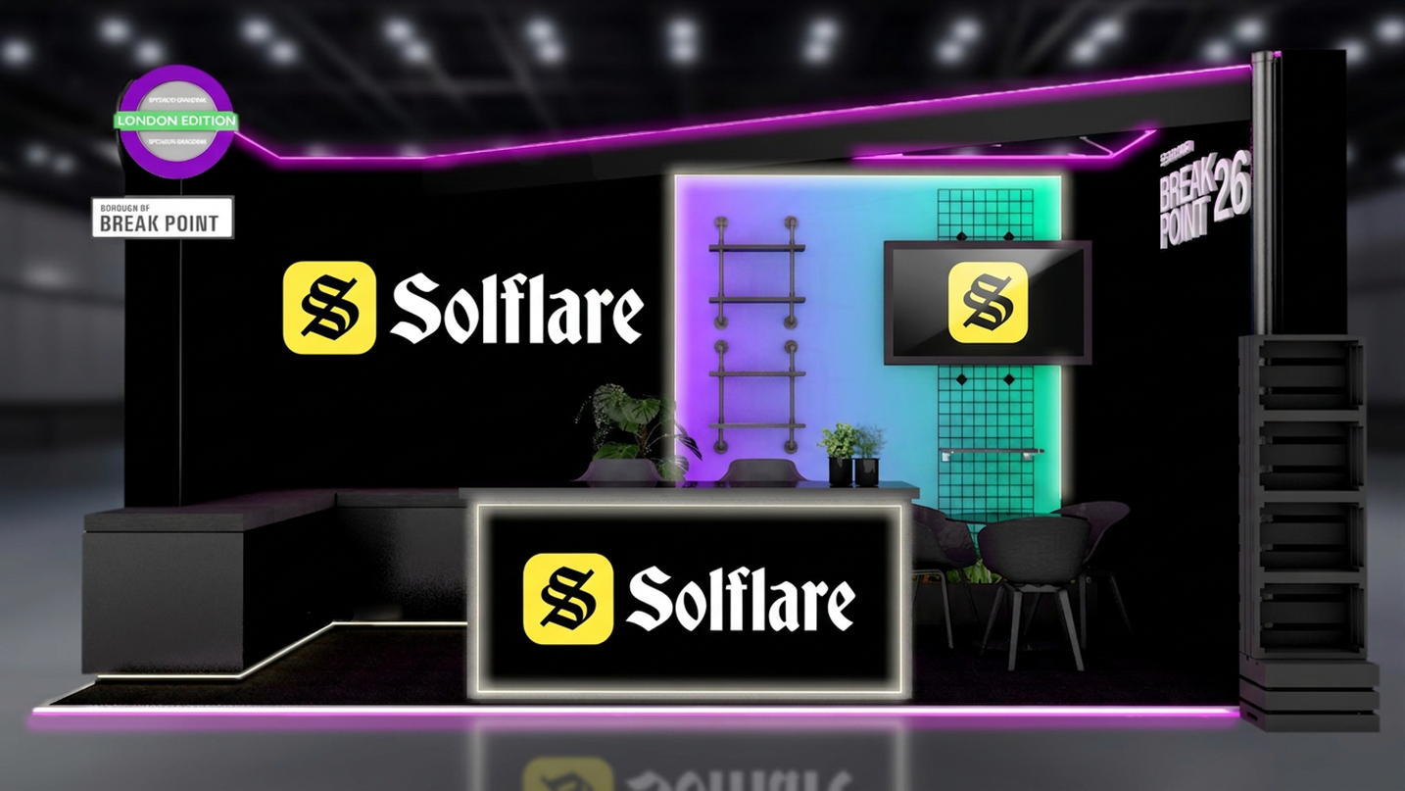
Sponsorships
BOOTHS
Luxury Suite (20’x10’)
Luxury Suites are where teams can showcase products and teams building on Solana. With added touches of luxury this is a premium, bigger space than a Deluxe Suite. Perfect for showcasing your products in an elevated manner, while having more prominent branding, signage and visibility.
What’s included?
  Turnkey 20’x10’ Suite to entertain, educate and network
  Fully furnished with integrated seating
  Custom signage on all inner walls
  Raised floor with LED trim
  Illuminated counter with storage
  LED metal roof design
  Wrap around bench with storage
  55’’ Monitor (incl. USB and HDMI input)
  Power socket
  Recognition on conference website and in conference materials, with amplification on Breakpoint social, owned marketing channels, and more.
  (2) Design Revision Rounds
Investment:
Passes:
$80,000
10 GA
Notes:
‹#›

Slide 11

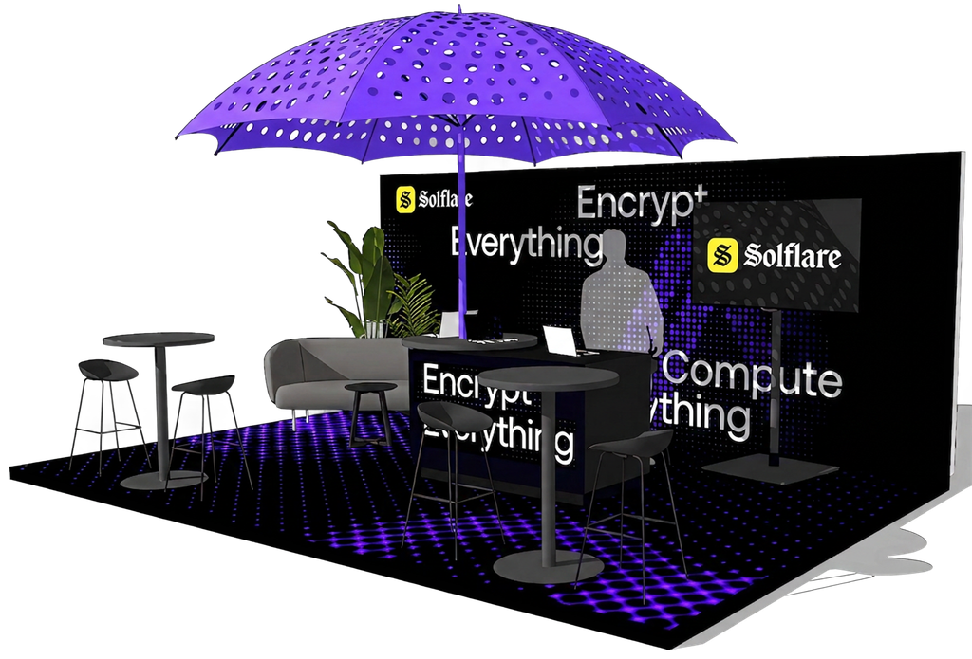
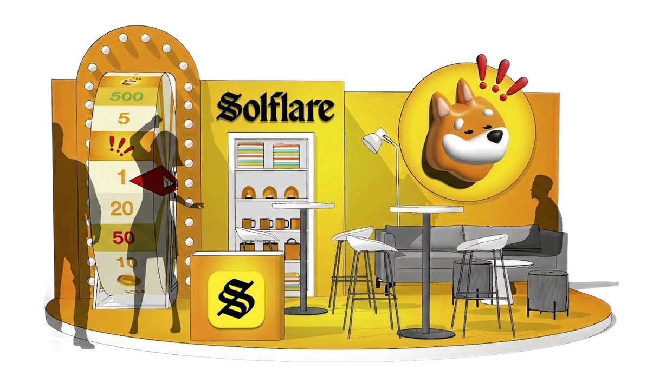
Sponsorships
BOOTHS
Custom Booth (Concept)
Make your mark and stand out at Breakpoint 2026 with a custom designed turnkey suite - the ultimate space to host, connect, and showcase your brand.
This suite includes premium furnishings and an even more creative activation experience. The booth will be custom designed together with the Solana Production team, uniquely catered to your brand.
What’s included?
  Turnkey Custom Designed Booth
  Fully furnished with integrated seating
  Custom signage & custom design
  Power distribution to the booth
  Recognition on conference website and in conference materials, with amplification on Breakpoint social, owned marketing channels, and more.
  (3) Design Revision rounds
***PRICING VARIES DEPENDING ON CUSTOMIZATION BUILD AND REQUESTS
Investment:
Passes:
$120,000+
*starting price
12 GA
Notes:
‹#›

Slide 12



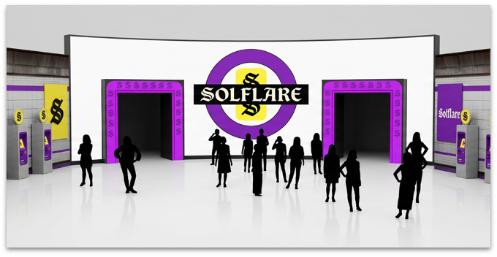
Sponsorships
GENERAL
WIFI (Official Provider)
Registration Powered By
The official WiFi network powered by your brand. Imagine your logo as the gateway every attendee uses to connect!
Position your brand prominently alongside Solana Breakpoint as attendees register for the event, creating a striking first impression at the most frequented spot!
What’s included?
What’s included?
  Your brand name as the SSID
  Your custom WiFi name and password
  Branded Banner in the Grand Hall
  Recognition on conference website and in conference materials, with amplification on Breakpoint socials, owned marketing channels and more.
  Your brand featured on all registration kiosks, with your logo as the “Registration powered by” on all registration kiosks.
  Display advertising on TV screens on registration walls and metro wall.
  Added graphics on the wall registration walls
  Recognition on conference website and in conference materials, with amplification on Breakpoint socials, owned marketing channels and more.
Investment:
Passes:
Investment:
Passes:
$150,000
10 GA
$85,000
5 GA
Notes:
‹#›

Slide 13


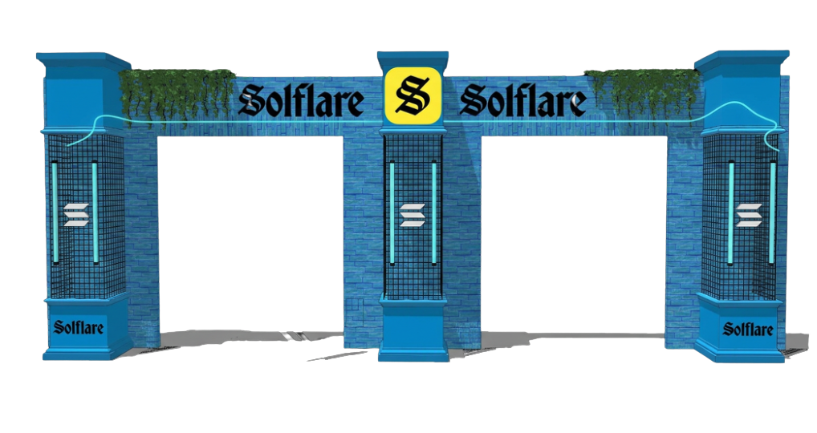
Sponsorships
GENERAL
Dev Cave
Get in touch with the builders. Connect with programmers. Hackathon will offer the opportunity to brand directly with those who contribute to building the ecosystem.
Perfect to catch-up and network in a laid back setting.
What’s included?
  Branding on Entrance gate
  2400 sq feet to accommodate visitors
  Custom furniture / pillows
  Custom branding and signage
  Branded banner in the Grand Hall
  Recognition on conference website and in conference materials, with amplification on Breakpoint social, owned marketing channels, and more.
Investment:
Passes:
$200,000
12 GA
Notes:
2x 65 inch scherm op stand + speakers
100x silent disco headset
2x mic
‹#›

Slide 14

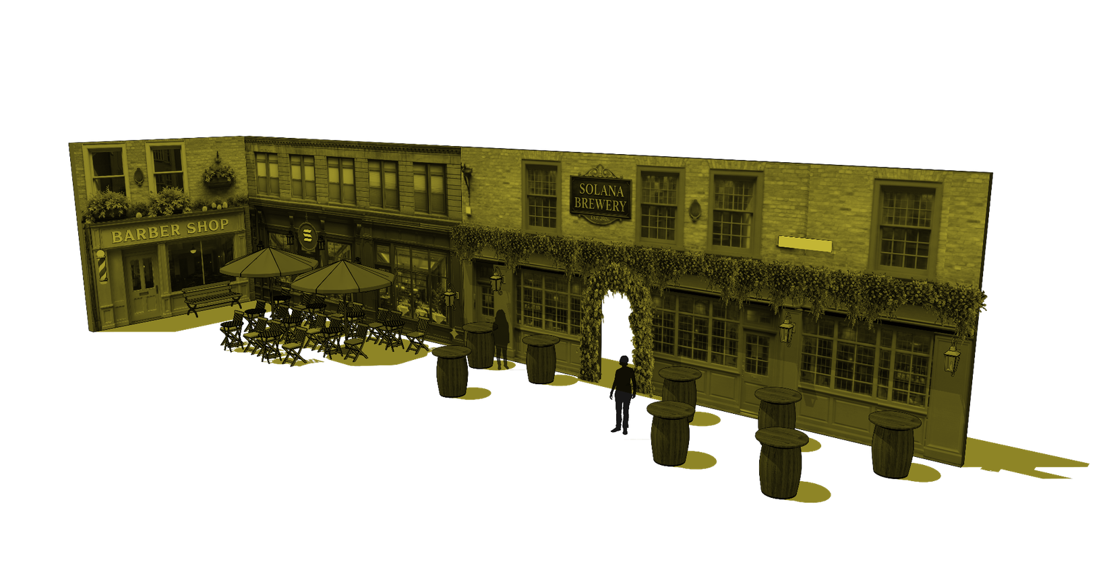
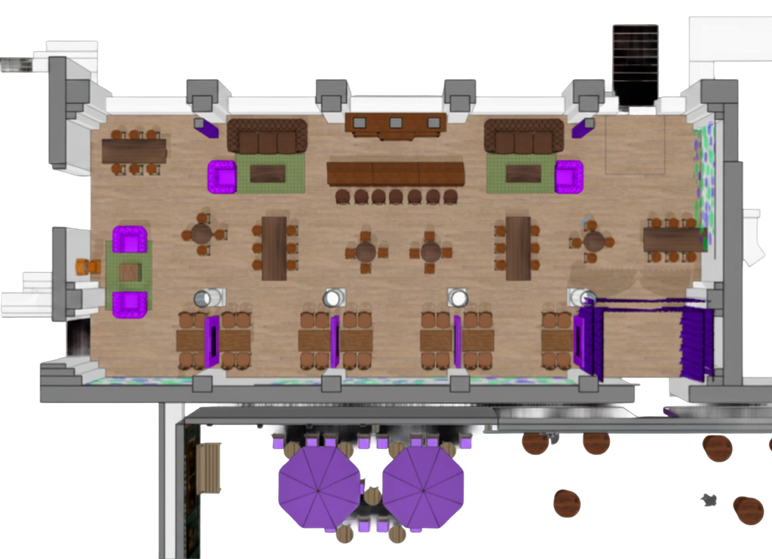
Sponsorships
F&B
Trade Brewery - The Grand Hall
The trade brewery will provide an unique location for gathering and community. Not only the perfect place to unwind, but here you can come together with your guests, partners, and founders in a really fun and premium setting.
What’s included?
  A fully staffed and operated pub bar
  Custom branded beer glasses
  Custom branding and signage
  Customizable Trading desks
  Branded banner in the Grand Hall
  Recognition on conference website and in conference materials, with amplification on Breakpoint social, owned marketing channels, and more.
Investment:
Passes:
$350,000
15 GA
Notes:
‹#›

Slide 15


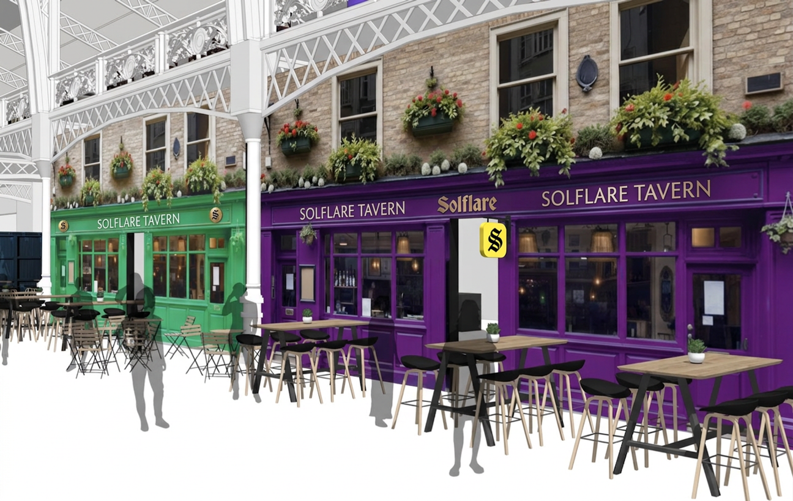
Sponsorships
F&B
The Taverns - The Grand Hall
Fuel the community’s spirit and energy at the 2-day Breakpoint event! Immerse yourself in the global market ambiance as we transform Breakpoint into a vibrant hub featuring iconic flavors from around the world. Be the brand that energizes the heart of the gathering!
What’s included?
  Branding on the tavern facades in the Grand Hall
  Branded items on furniture surrounding and inside the taverns
  Branded Banner in the Grand Hall
  Mentioning in Press Release
  Recognition on conference website and in conference materials, with amplification on Breakpoint social, owned marketing channels, and more.
Investment:
Passes:
$250,000
15 GA
Notes:
‹#›

Slide 16
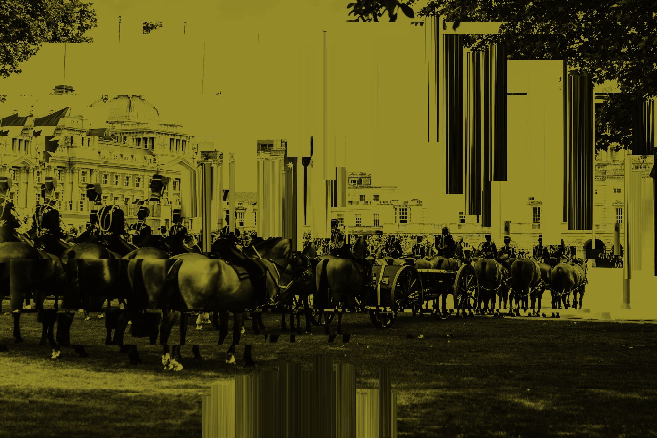
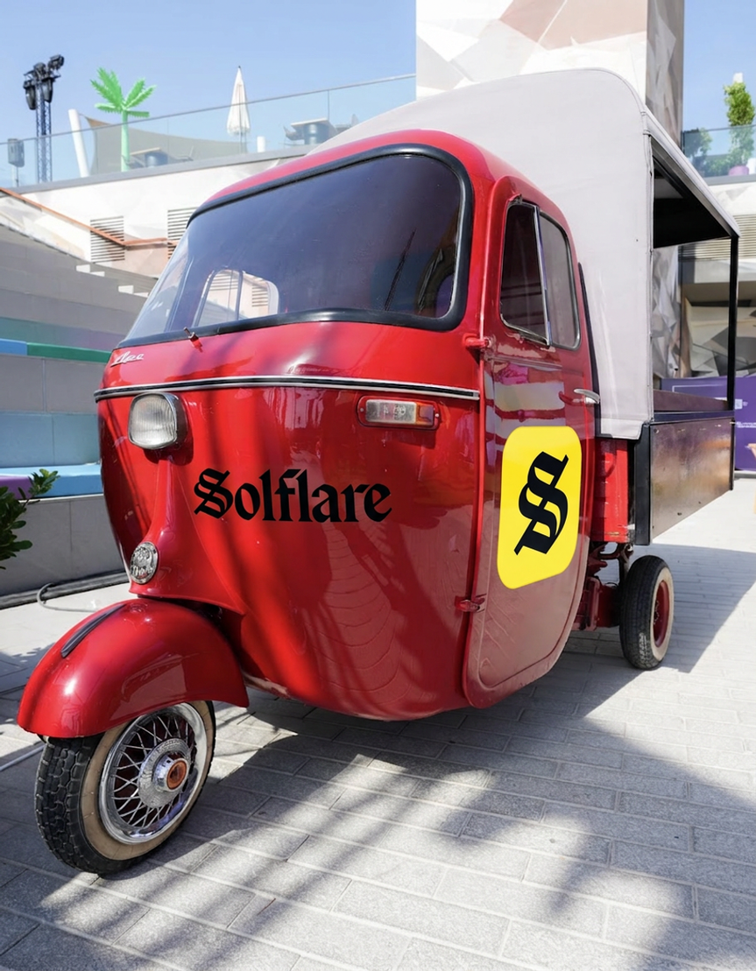
Sponsorships
Custom sponsor Breakpoint ‘25
Abu Dhabi
F&B
Coffee’o’clock
2 Sponsors (4 carts each) - 1 LEFT
The Solana Events team is fueled on coffee, and so is a big portion of the Solana Ecosystem! Be the saviour on site by providing top tier java in collaboration with Raposa Coffee.
This crowd favorite package includes custom branded cups at (4) coffee stations spread across the venue that will be fully staffed and operated by Raposa Coffee, keeping our community fueled and energized!
What’s included?
  Your brand on (4) coffee carts placed around the venue
  All (4) carts will be fully staffed and operated by Raposa Coffee
  Custom Branded Coffee Cups
  Recognition on conference website and in conference materials
Investment:
Passes:
$100,000
10 GA
Notes:
‹#›

Slide 17


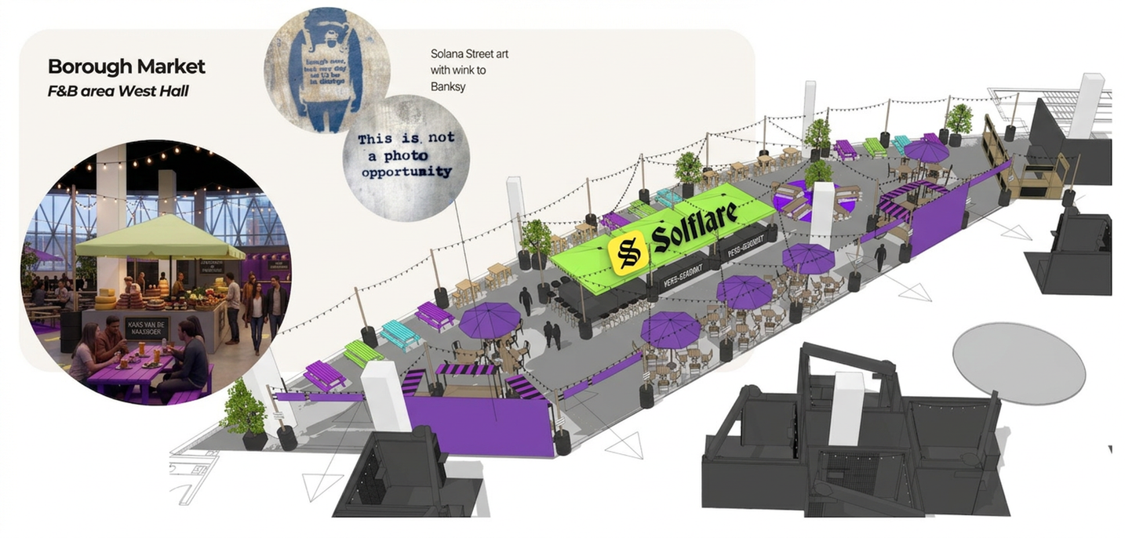
Sponsorships
F&B
Borough Market - West Hall Level 1
Borough markets are vibrant, create communities through the shared food and relaxed vibes.
In the West Hall Level 1 a Solana borough market will be created. With festoon lighting and colorful
What’s included?
  Branding on all Food Stations inside the Borough Market.
  Custom colours and branding of parasols
  Street art in brand
  Additional signage and branding
  Branding on all pop-up snack stations fueled by your brand, throughout the space
  Branded banner in the Grand Hall
  Mentioning in Press Release
  Recognition on conference website and in conference materials, with amplification on Breakpoint social, owned marketing channels, and more.
Investment:
Passes:
$500,000
15 GA
Notes:
‹#›

Slide 18


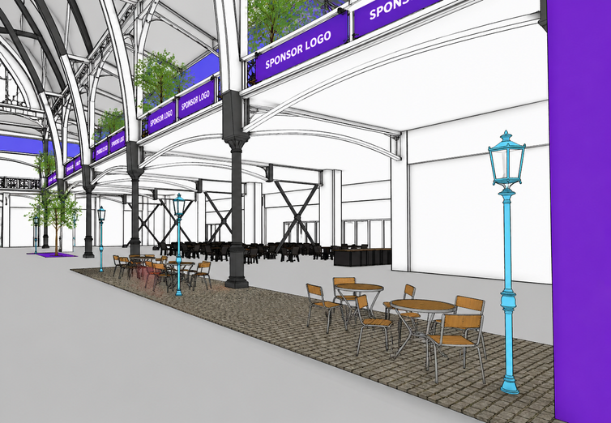
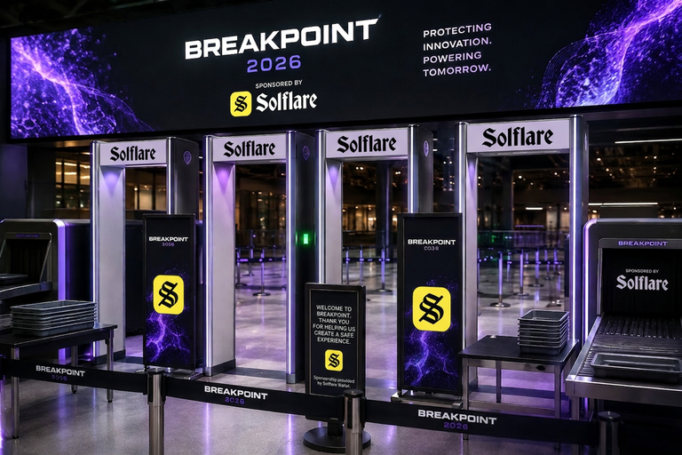
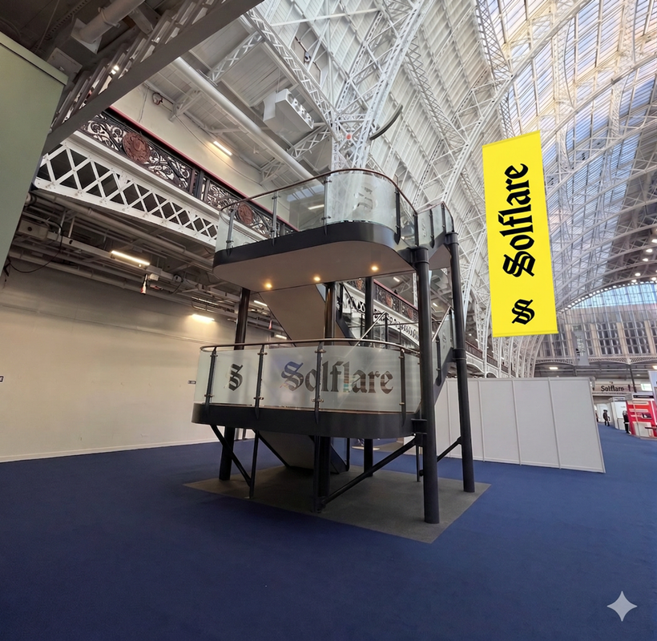

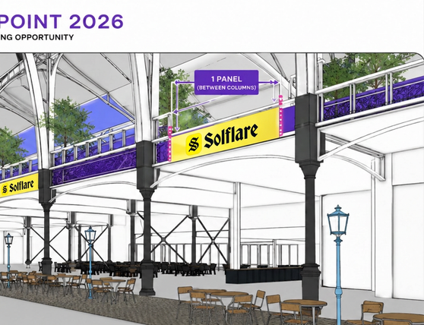
Sponsorships
BRANDING
Large Physical Branded Banner
Security Physical Branding
Branding of Glass Staircase
6 Sponsors
1 Sponsor
1 Sponsor
What’s included?
What’s included?
What’s included?
  1x Branded Banner from Mezzanine Balcony in the Grand Hall
  Banner size: 3 ft 7.3’’ (H) × 31 ft 2.0’’ (W)
  Recognition on conference website and in conference materials, with amplification on Breakpoints social, owned marketing channels, and more.
  Dedicated physical branding on all security machines at the main entrance
  Recognition on conference website and in conference materials, with amplification on Breakpoints social, owned marketing channels, and more.
  1x Physical Branding on the glass staircase in the Grand Hall
  Recognition on conference website and in conference materials, with amplification on Breakpoints social, owned marketing channels, and more.
Investment:
Passes:
Investment:
Passes:
Investment:
Passes:
$30,000
2 GA
$17,500
2 GA
$35,000
2 GA
Notes:
‹#›

Slide 19

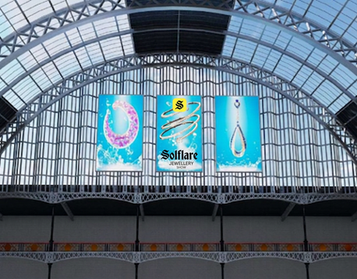
Sponsorships
BRANDING
Large Premium Digital Branding
Large Premium Digital Branding
Large Premium Digital Branding
1 sponsor - left
1 sponsor - middle
1 sponsor - right
2
What’s included?
What’s included?
What’s included?
  1 LED screen above Grand Hall foyer
  LED screen size - 31′ 2″ tall × 16′ 6½″ wide
  Recognition on conference website and in conference materials, with amplification on Breakpoints social, owned marketing channels, and more.
  1 LED screen above Grand Hall foyer
  LED screen size - 31′ 2″ tall × 16′ 6½″ wide
  Recognition on conference website and in conference materials, with amplification on Breakpoints social, owned marketing channels, and more.
  1 LED screen above Grand Hall foyer
  LED screen size - 31′ 2″ tall × 16′ 6½″ wide
  Recognition on conference website and in conference materials, with amplification on Breakpoints social, owned marketing channels, and more.
Investment:
Passes:
Investment:
Passes:
Investment:
Passes:
$30,000
2 GA
$30,000
2 GA
$30,000
2 GA
Notes:
‹#›

Slide 20
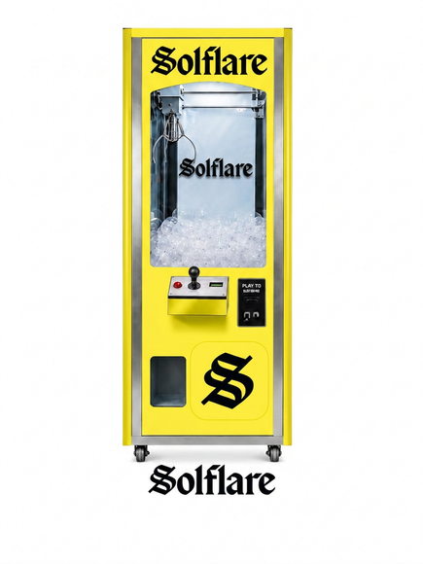

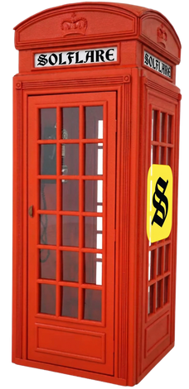

Sponsorships
ACTIVATIONS
Phone Booth
Pinball Machine
Claw Machine
4 Sponsors (2 booths per sponsor)
1 Sponsor (2x machines)
1 Sponsor
What’s included?
What’s included?
What’s included?
  Physical branding on 2 phone booths
  Customizable branding
  Recognition on conference website and in conference materials, with amplification on Breakpoints social, owned marketing channels, and more.
  2x Customized digital pinball machines
  Recognition on conference website and in conference materials, with amplification on Breakpoints social, owned marketing channels, and more.
  Customized Claw machine
  Recognition on conference website and in conference materials, with amplification on Breakpoints social, owned marketing channels, and more.
Investment:
Passes:
Investment:
Passes:
Investment:
Passes:
$10,000
2 GA
$9,000
2 GA
$6,500
2 GA
Notes:
‹#›

Slide 21
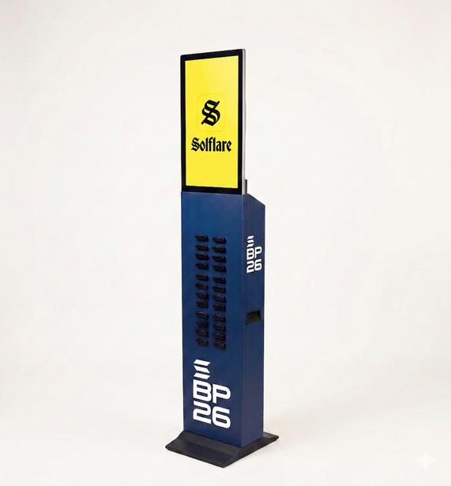
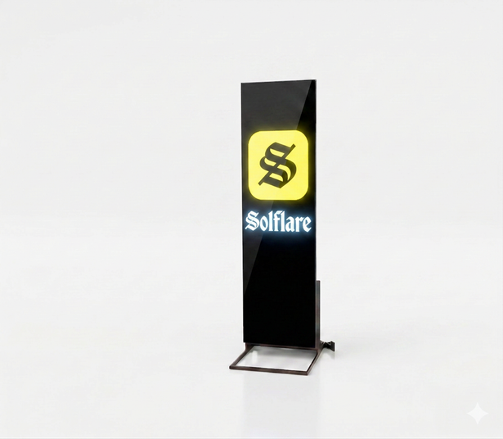
Sponsorships
BRANDING
LED Screens
Branded Power Bank Charging Kiosk
10 Sponsors
3 Sponsors (2 kiosk each)
What’s included?
What’s included?
  Digital branding on free standing LED screens
  Dimensions: 2-1/2" (w) × 75-5/8" (h)
  Per screen, multiple connected screens optional
  Recognition on conference website and in conference materials, with amplification on Breakpoints social, owned marketing channels, and more.
  2 fully branded power bank charging kiosks
  Per kiosk: 24 power banks and 24 spare power banks including logo branding
  Recognition on conference website and in conference materials, with amplification on Breakpoints social, owned marketing channels, and more.
Investment:
Passes:
Investment:
Passes:
$5,000
*per screen
2 GA
$20,000
2 GA
per marketing wrap
Notes:
‹#›

Slide 22
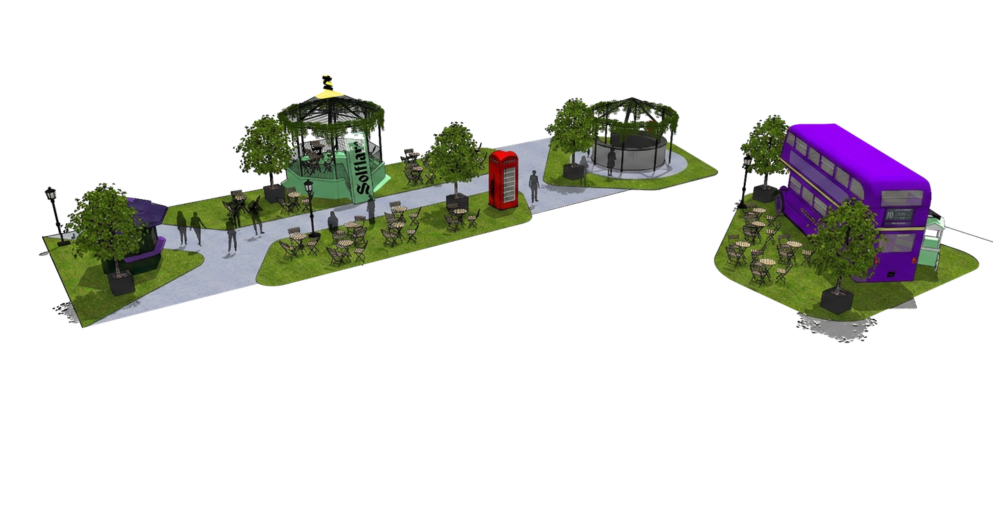
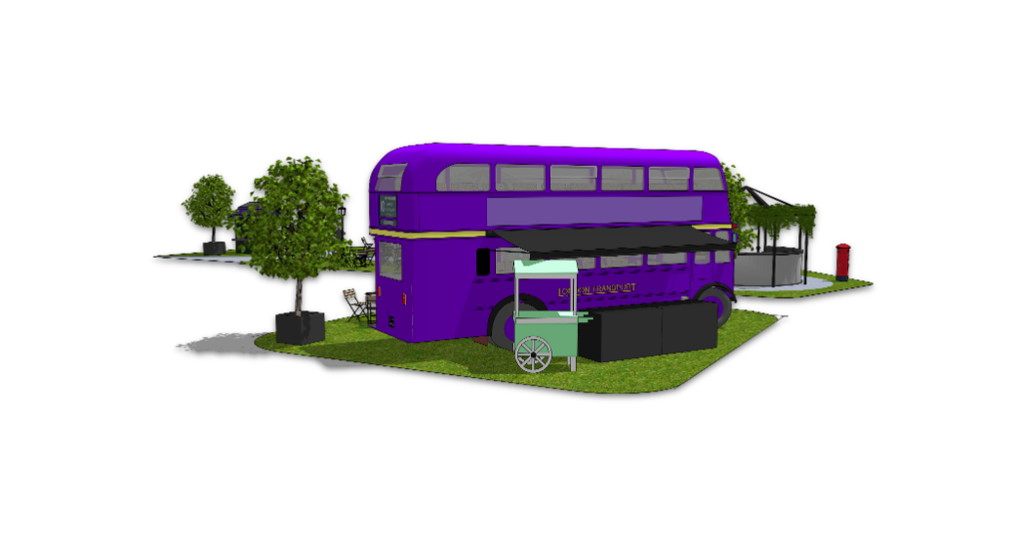
Sponsorships
GENERAL | F&B
Afternoon Tea Lounge
Step into the Afternoon Tea Lounge — a break from the buzz, inspired by London tradition and elevated with Breakpoints signature neon edge.
Here you can host VIP guests, partners, and founders in a relaxed, premium setting aboard a custom-built double-decker vignette tea salon.
What’s included?
  A fully staffed and operated Tea Lounge
  Custom branded cups
  Custom branding and signage
  Recognition on conference website and in conference materials, with amplification on Breakpoint social, owned marketing channels, and more.
Investment:
Passes:
$120,000
8 GA
Notes:
‹#›

Slide 23

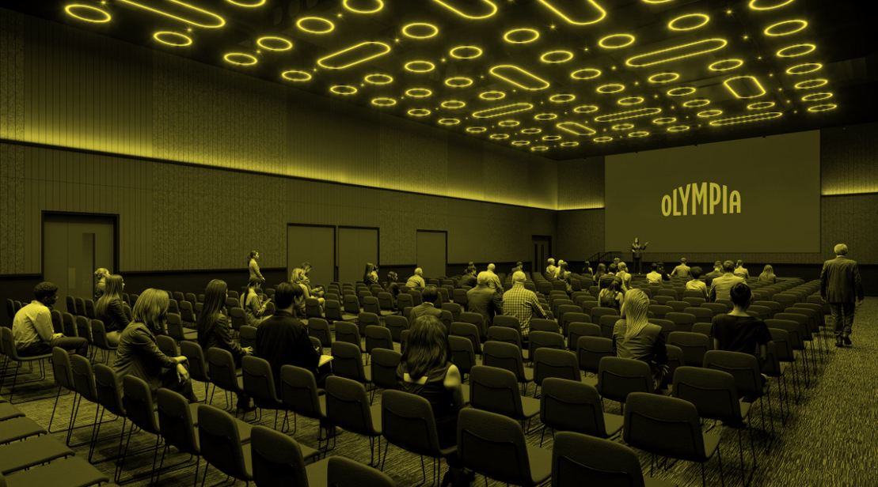

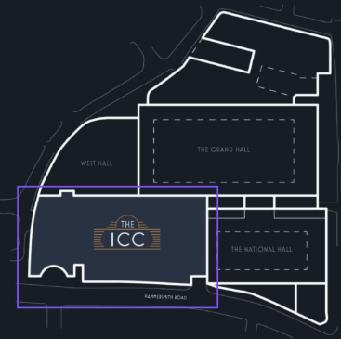
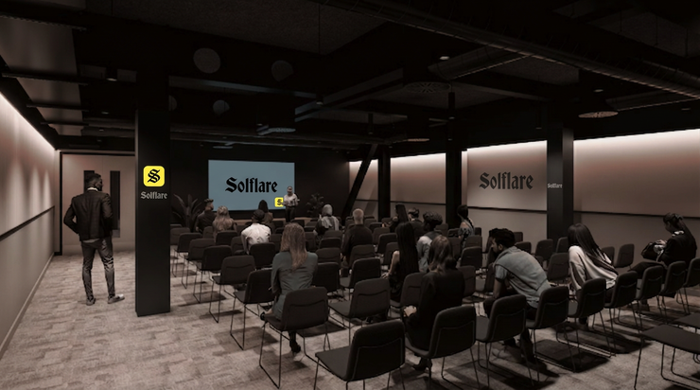
Sponsorships
EVENT SIDE SUMMIT SPACE
November 13 - SOLD
November 14 - SOLD
November 15 - SOLD
What’s included?
    Olympia: The ICC Level 2 with 5 spaces and a max capacity of 370 pax
    LED Screen: 4,8 x 2,7m (15.7 ft x 8.9 ft)
    24.6 ft × 8.2 ft × 2.0 ft stage and complete AV Setup
    AV Staff for the day (1x Audio Engineer, 1x Video Technician, 1x Lighting Technician & 1 Stage Hand)
    Full F&B services - Baking goods, hot buffet lunch menu, afternoon bites. *** Current sponsorship is budgeted for F&B for 250 attendees)
    Brandable assets throughout the event space, flexible to your needs
    Furniture and Decoration provided throughout the space
    Hosting services at registration and during the day
    Ten (10) General Admission tickets
Investment:
Passes:
$100,000
10 GA
Notes:
‹#›

Slide 24


BRING ALL YOUR
crazy
fun
wild
ideas
We want to hear from you!
Please contact us at events@solana.org to discuss your ideas for Breakpoint or any questions you may have.
Notes:
‹#›

Slide 25


THANK YOU
Notes:
‹#›

